Slide 1

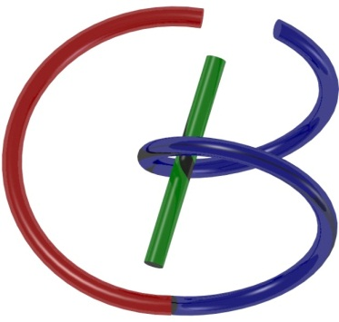
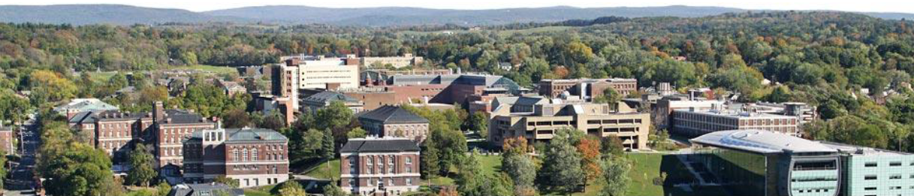
38655 BMED-2300-02
Lecture 16: Nuclear Physics
Ge Wang, PhD
Biomedical Imaging Center
CBIS/BME, RPI
wangg6@rpi.edu
March 23, 2018

Slide 2
BB Schedule for S18
Tue | Topic | Fri | Topic
1/16 | Introduction | 1/19 | MatLab I (Basics)
1/23 | System | 1/26 | Convolution
1/30 | Fourier Series | 2/02 | Fourier Transform
2/06 | Signal Processing | 2/09 | Discrete FT & FFT
2/13 | MatLab II (Homework) | 2/16 | Network
2/20 | No Class | 2/23 | Exam I
2/27 | Quality & Performance | 3/02 | X-ray & Radiography
3/06 | CT Reconstruction | 3/09 | CT Scanner
3/20 | MatLab III (CT) | 3/23 | Nuclear Physics
3/27 | PET & SPECT | 3/30 | MRI I
4/03 | Exam II | 4/06 | MRI II
4/10 | MRI III | 4/13 | Ultrasound I
4/17 | Ultrasound II | 4/20 | Optical Imaging
4/24 | Machine Learning | 4/27 | Exam III
Office Hour: Ge Tue & Fri 3-4 @ CBIS 3209 | wangg6@rpi.edu
Kathleen Mon 4-5 & Thurs 4-5 @ JEC 7045 | chens18@rpi.edu

Slide 3
Nuclear Physics
General Perspective
Radioactivity
Decay Mechanisms
Decay Modeling
Tracer Production
Devices
Milking Modeling
Data Acquisition
Gamma Camera
Coincidence Detection

Slide 4
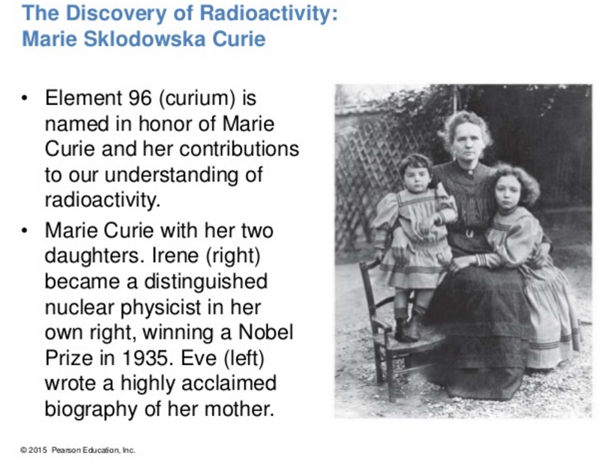
Marie Curie

Slide 5
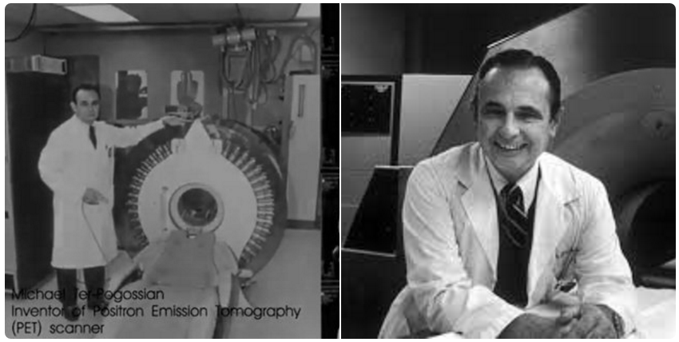
Michael Ter-Pogossian
Michel Matthew Ter-Pogossian (April 21, 1925 – June 19, 1996) was one of the fathers of positron emission tomography (PET), the first functional brain imaging technology. PET can evaluate the brain during mental processes versus looking at the structure through conventional CT.

Slide 6
X-ray CT
Averaged
Linear Attenuation
Over Whole X-ray Spectrum
Conventional CT
Rotation
Photon-integrating
Detector
Air
Water
Gold
10mg/ml
Fat
50%
Full Spectrum
For K-edges
In Many Energy Bins
Spectral Molecular CT
600
X-ray Tube
Iodine
20mg/ml
Calcium 150mg/ml
Photon-counting
Detector
Multi-material Phantom
0

Slide 7
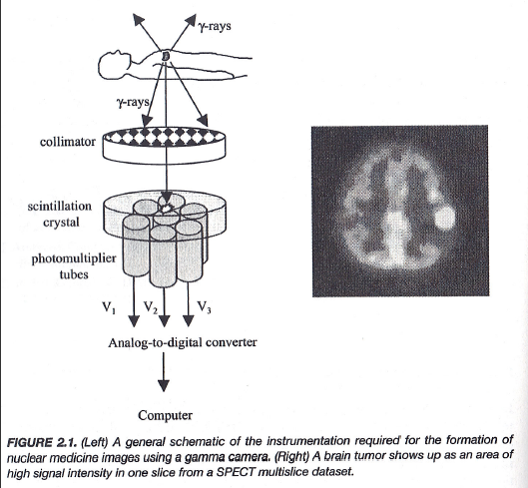

Basic Idea of Nuclear Imaging

Slide 8
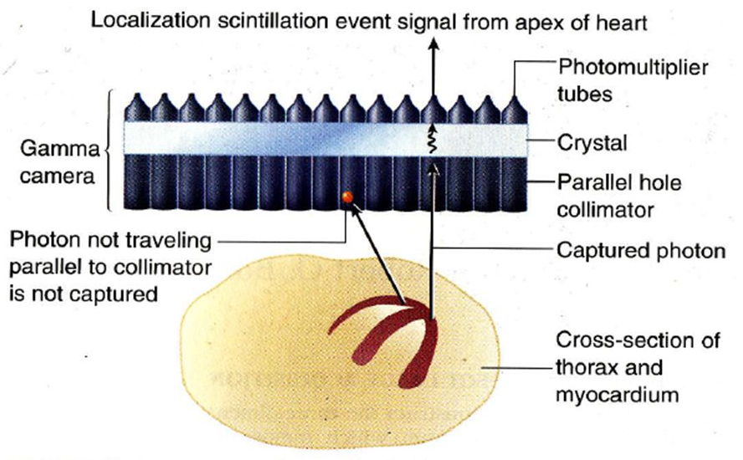
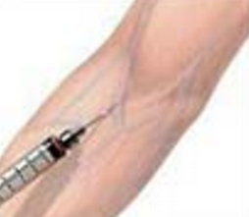
Further Illustrated

Slide 9
Physical Principles
Unstable Isotope as Tracer Molecule (Radionuclide)
Administered Intravenously or Orally
Metabolic Process Involved
Gamma Rays Emitted
Measurement of Metabolism/Function

Slide 10
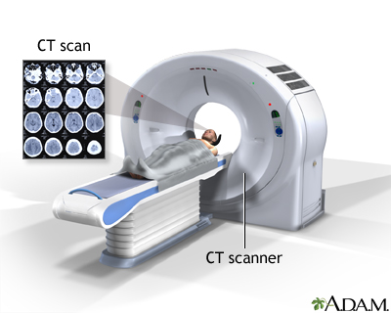
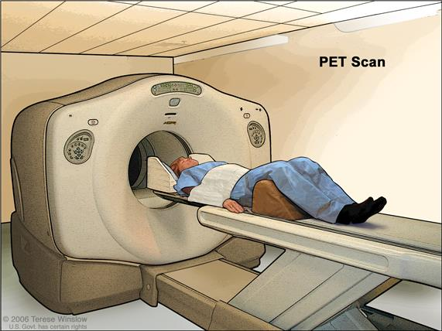
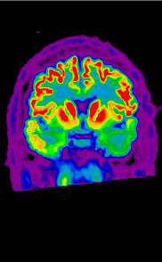
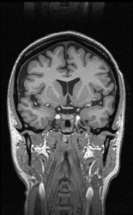
Similarities & Differences
Similarities
Similar Energy Levels
Straight Ray Geometries
Line Integrals
Tomographic Recons
Differences
External vs Internal Sources
Anatomical vs Functional
High vs Low Flux/Resolution
Low vs High Sensitivity

Slide 11
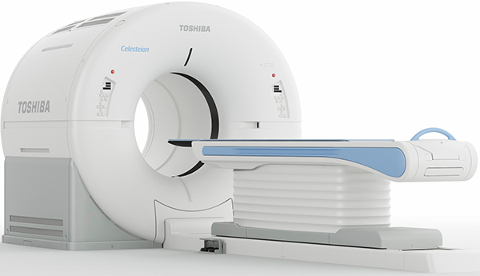
PET-CT
Major Strength of Nuclear Imaging:
Label Most Metabolites
Highly Sensitive Biochemically
In the Best Form of the Hybrid Scanner,
Such as PET-CT & PET-MRI

Slide 12
Nuclear Physics
General Perspective
Radioactivity
Decay Mechanisms
Decay Modeling
Tracer Production
Devices
Milking Modeling
Data Acquisition
Gamma Camera
Coincidence Detection

Slide 13
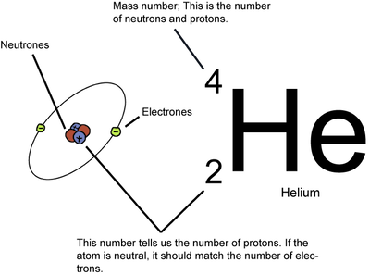
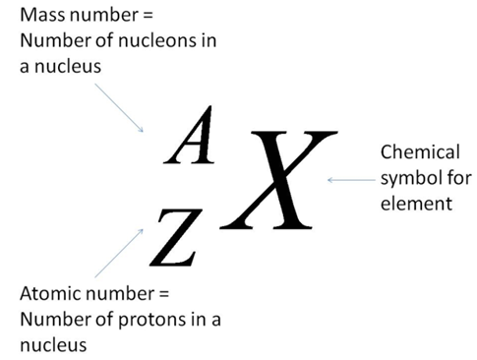
Atomic Number & Mass Number
Atomic Number (Z): the number of protons in its nucleus
Atomic Weight (≃A): In most cases the mass number, equal to the total number of protons and neutrons

Slide 14
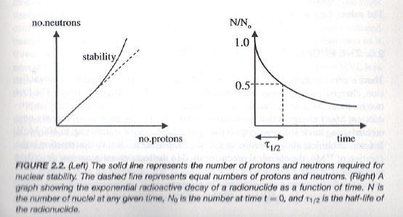
Isotopes
Isotopes of a Chemical Element Have the Same Atomic Number but Different Mass Numbers (Different Numbers of Neutrons)
Examples: ¹²Carbon and ¹⁴C
Isotopes May Emit Radiation

Slide 15
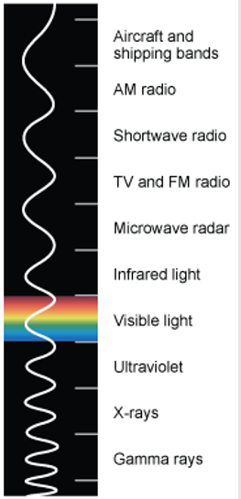
Gamma Rays
Unstable Nucleus Changes from a Higher to Lower Energy State through Gamma Ray Emission
Gamma Rays Have Similar Energies as X-rays but Are Generated Differently:
X-ray through Electron Interaction
Gamma-ray through Isometric Transition

Slide 16
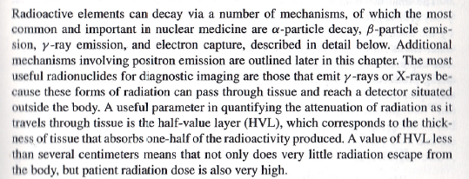
Decay Types
Alpha (α)
Beta (β- & β+)
Gamma (γ)
Electron Capture

Slide 17
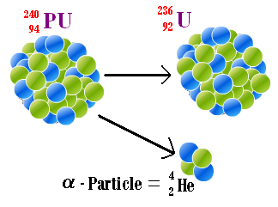
Alpha Decay
Alpha-particle Decay/Nucleon Emission
Heavy Damage to Tissue
Example: α-photon of 3-7 MeV

Slide 18
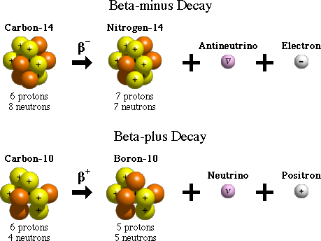
Beta Decay

Slide 19
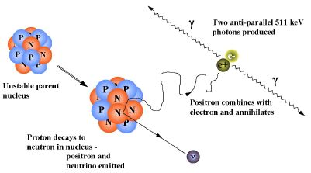
Positron Emission

Slide 20
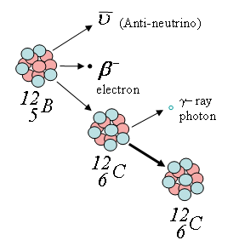
Gamma Decay
Immediate Release of a γ-photon
Metastable State for
Delayed Release of
a γ–photon (& an Antineutrino)

Slide 21
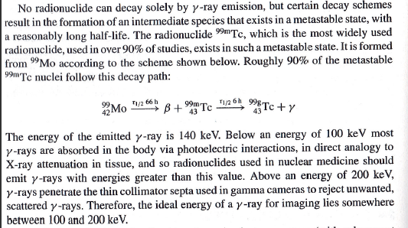
Gamma Decay: ^{99m}Tc

Slide 22
Electron Capture
Change a Proton to a Neutron
+ X-rays or Auger Electrons
+ Inner Bremsstrahlung
Excited Nucleus

Slide 23
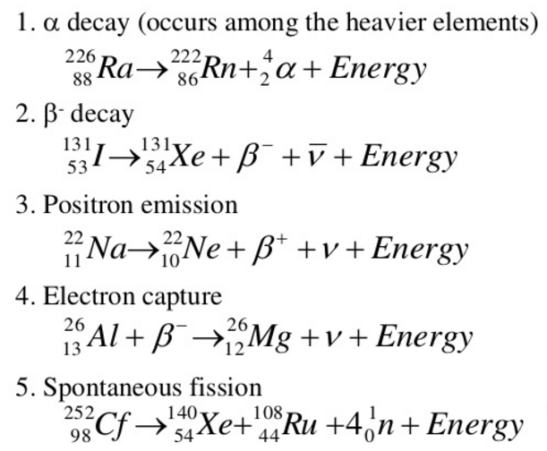

Another Classification
https://www.slideshare.net/KenCzerwinski/chem-312-lect-1-2013-intro-show

Slide 24
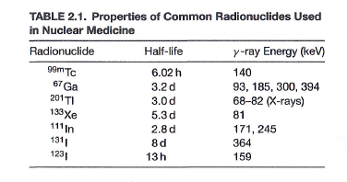
Common Tracers

Slide 25
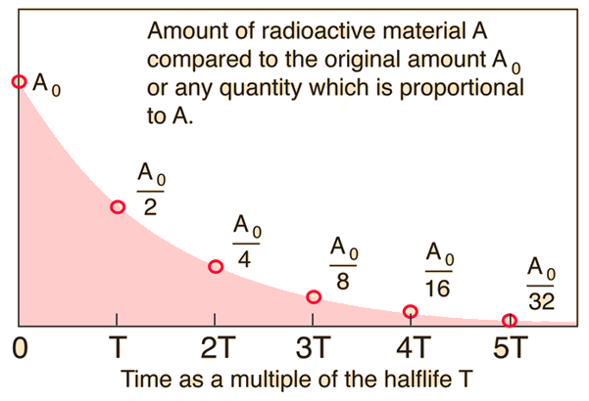
Exponential Decay

Slide 26
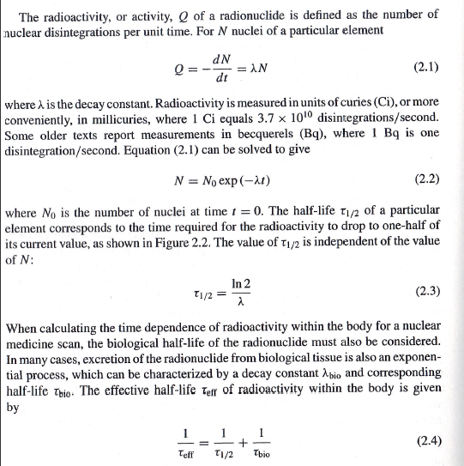
Mathematical Details

Slide 27
Nuclear Physics
General Perspective
Radioactivity
Decay Mechanisms
Decay Modeling
Tracer Production
Devices
Milking Modeling
Data Acquisition
Gamma Camera
Coincidence Detection

Slide 28
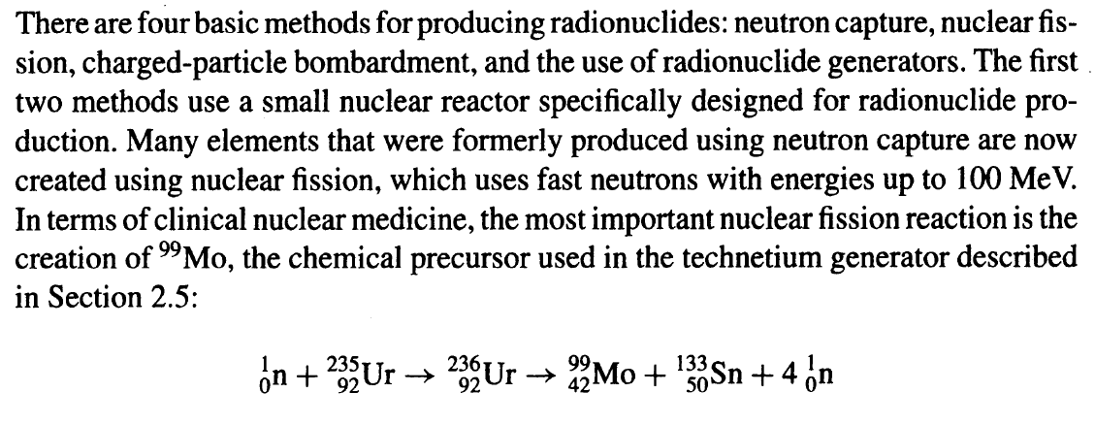
Four Methods

Slide 29
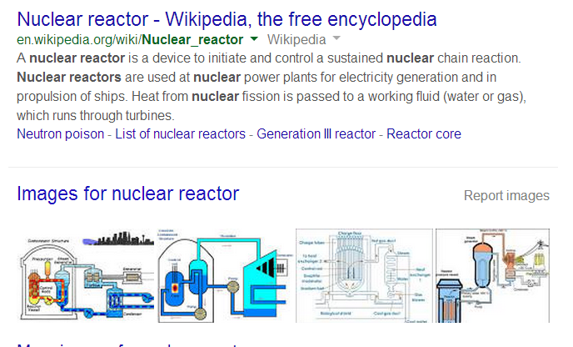
Nuclear Reactor (1st & 2nd Methods)
Neutron Capture & Nuclear Fission

Slide 30
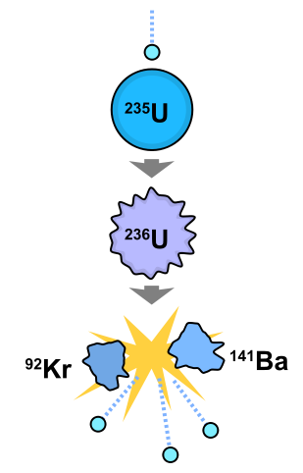
Nuclear Fission (2nd Method)
In nuclear physics, nuclear fission is either a nuclear reaction or a radioactive decay process in which the nucleus of an atom splits into lighter nuclei. The fission process often produces free neutrons and gamma photons, and releases a huge amount of energy.

Slide 31
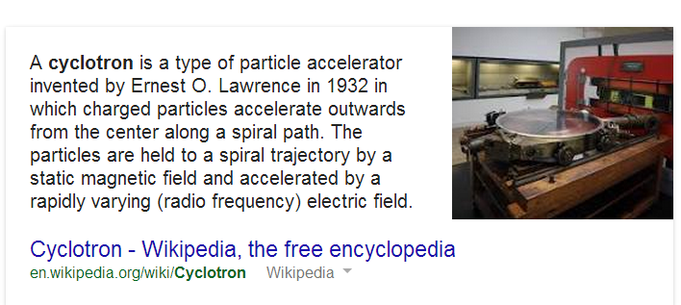
Cyclotron (3rd Method)

Slide 32
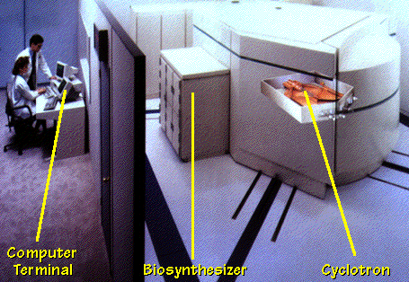
Cyclotron Example

Slide 33
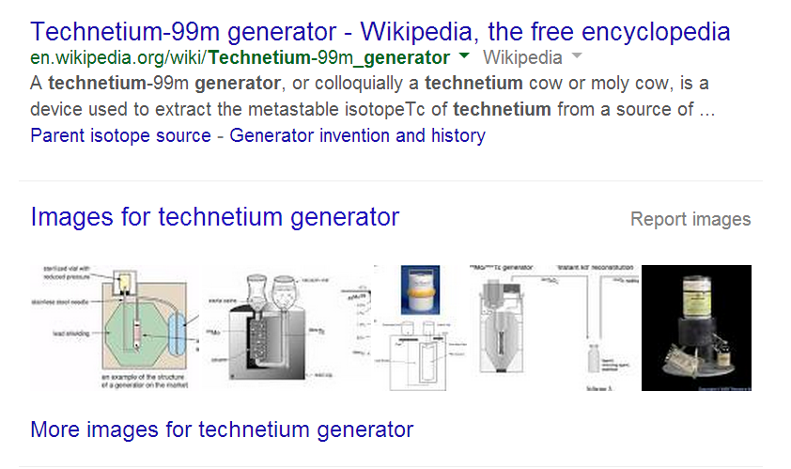
Generator (4th Method)

Slide 34
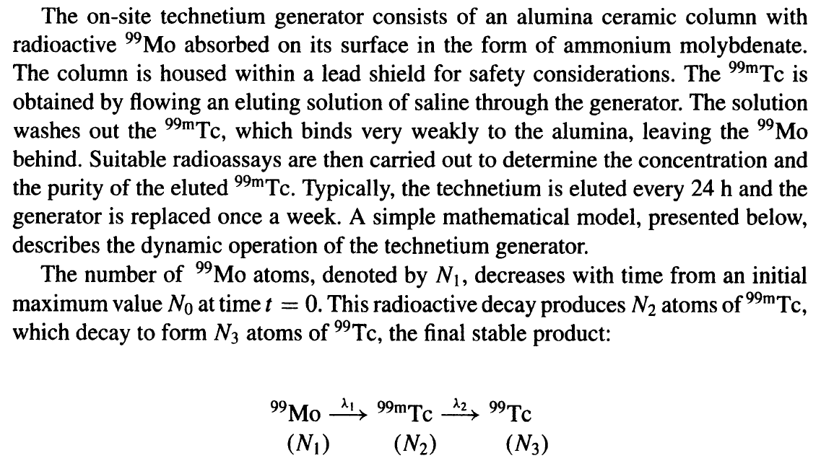
Two-step Process

Slide 35
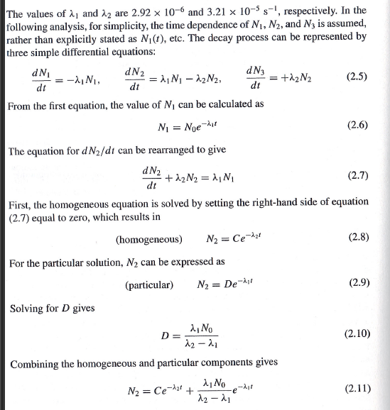
Dynamic Modeling

Slide 36
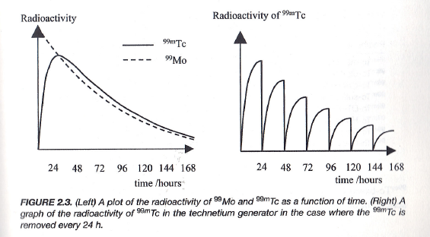
Daily Yield
The ratio of the two species is constant – the decay rate of the daughter is governed by the half-life of the parent.

Slide 37
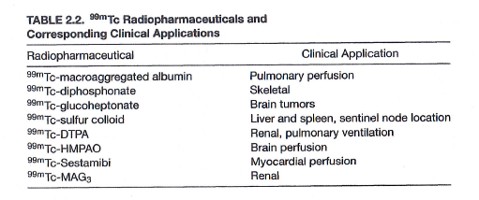
Clinical Applications

Slide 38
Nuclear Physics
General Perspective
Radioactivity
Decay Mechanisms
Decay Modeling
Tracer Production
Devices
Milking Modeling
Data Acquisition
Gamma Camera
Coincidence Detection

Slide 39
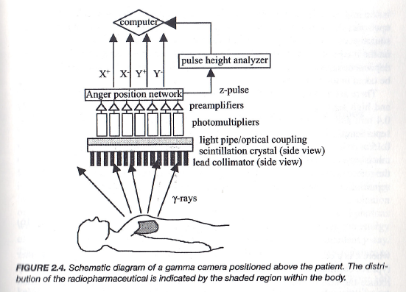
Gamma Camera

Slide 40
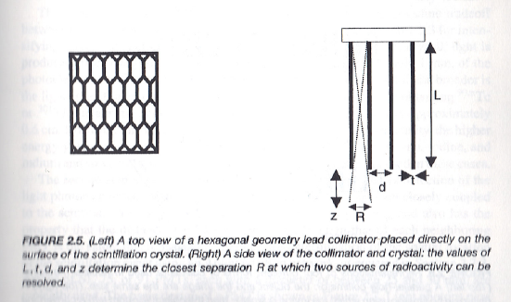
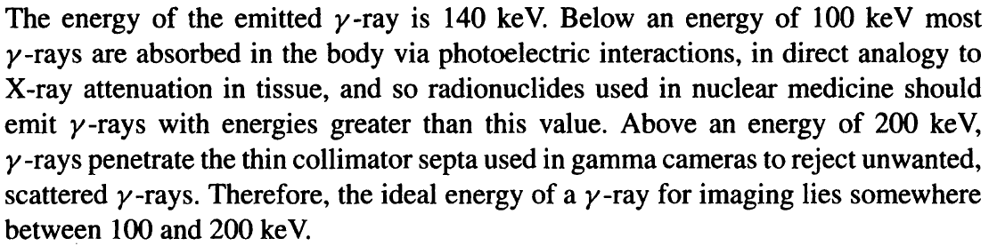
Collimator

Slide 41
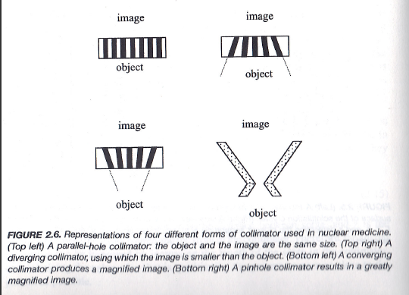

Slide 42
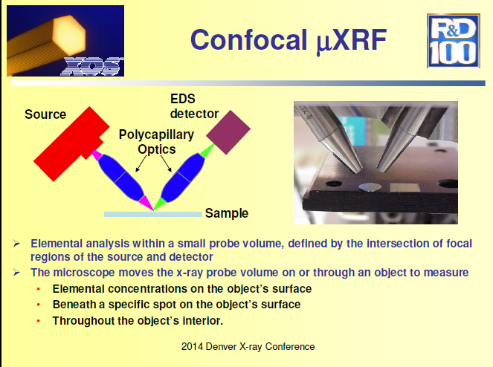
Polycapillary Lens of Gamma Rays?

Slide 43
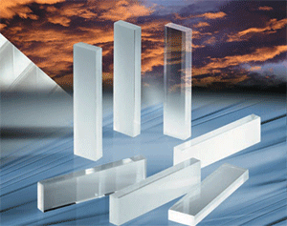
Crystal

Slide 44
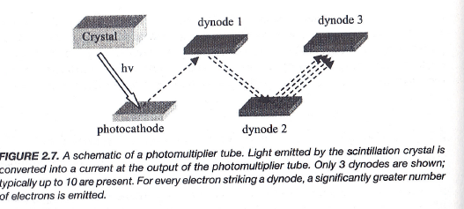
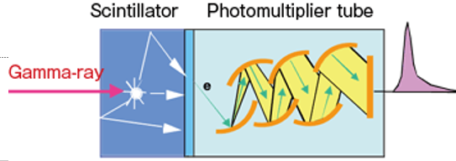
Signal Detection: PMT

Slide 45
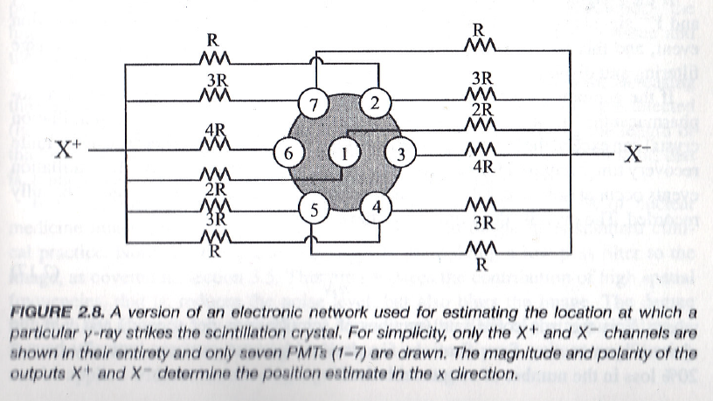
Signal Localization: Anger Network

Slide 46
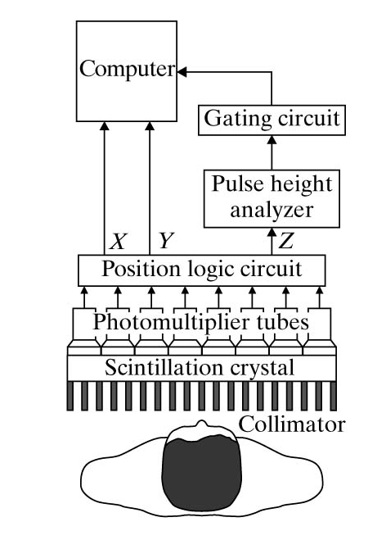
Planar Scintigraphy
Synchronize the Signal
Threshold the Signal
Localize the Signal
Light to Electric Signal
Gamma Photon to Light
Collimate Gamma Rays

Slide 47
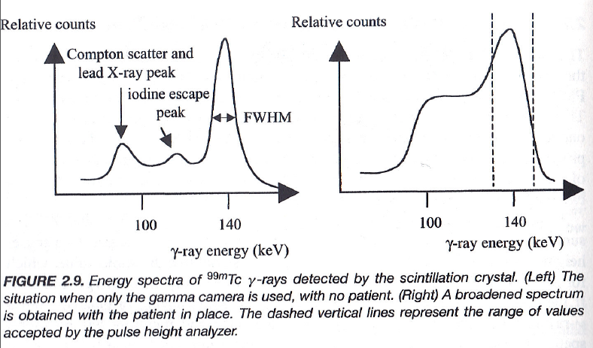
Energy Spectra

Slide 48
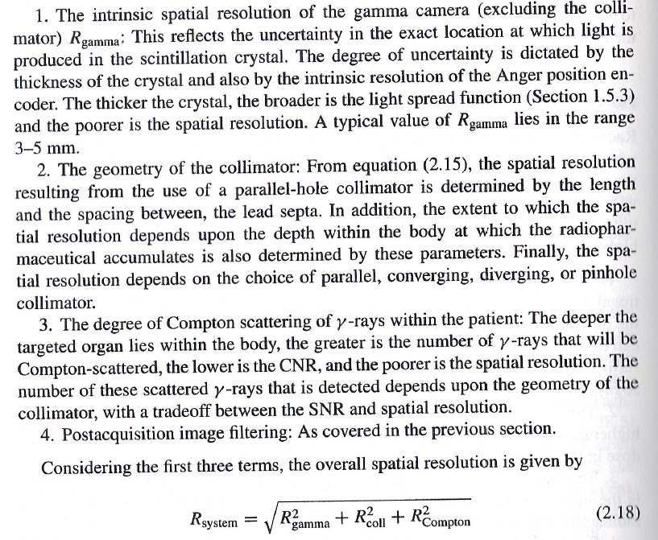
Spatial Resolution

Slide 49
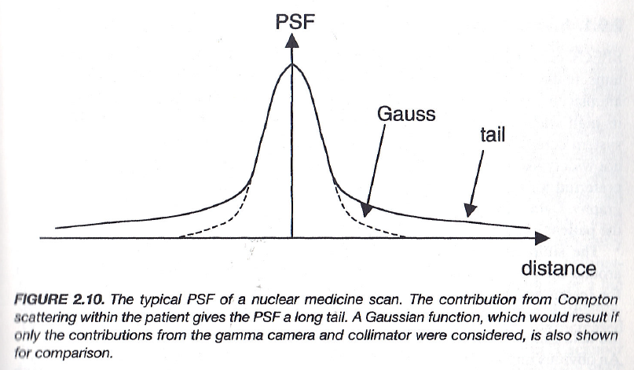
Point Spread Function

Slide 50
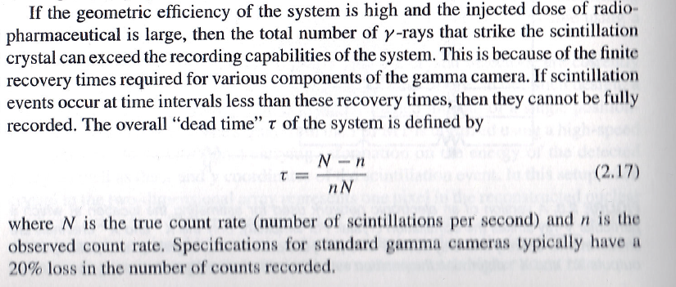

Dead Time
$$τ=\frac{1}{n}−\frac{1}{N}$$

Slide 51
FDG for Cancer Imaging
Positron emission tomography (PET) is a functional imaging technique that is used to observe metabolic processes in the body. If the biologically active molecule chosen for PET is fludeoxyglucose (FDG, produced in Cyclotron), an analogue of glucose, the concentrations of tracer imaged will indicate tissue metabolic activity as it corresponds to the regional glucose uptake. Use of this tracer to explore the possibility of cancer metastasis (i.e., spreading to other sites) is the most common type of PET scan (90% of current scans).

Slide 52

Coincidence Detection
Pulses from PMT Go through the Coincidence Circuit to Check if the Signals are from the Same Event
Signals Go through the Energy Window to Reject Scatters
Pulse Height Analyzer

Slide 53




Coincidence: Paired Pulses

Slide 54


Time of Flight Detection

Slide 55

BB16 Homework
Due Date: Same (1 Working Week Later)

